Slide 1
HS 200
SOCIAL ISSUES AND THE ENVIRONMENT
D.Parthasarathy
India Value Fund Chair Professor, Department of Humanities and Social Sciences
Associate Faculty and Convener, Centre for Excellence in Climate Studies
Associate Faculty, Centre for Policy Studies
Indian Institute of Technology Bombay
Email: ben.dp@iitb.ac.in; dp@hss.iitb.ac.in

Slide 2
Environmental issues and social science perspectives: Key aspects for the Indian Context
Conflicts and struggles
Access
Equity
Justice
Institutions
Governance

Slide 3
The difficult questions of Value and Justice
Valuing nature, ecosystems, natural resources
Economic value (production of goods and services)
Life support: breathing, living, pollution, water purification, cleaning up, regeneration, sustaining ecosystems, carbon sequestration, salinity control, disease control
Social and cultural value (life-fulfilling): religion, aesthetics, recreation
Conservation: future use
Valuing as a way of organizing and using information to make informed choices - beyond instrumental use of resources

Slide 4
Environment and Justice: Inter and Intra-generational
NIMBY principle and environmental injustice: landfills, dumping grounds, hazardous facilities
Climate change and justice
Access to the environment, R&R, Compensation and Justice: short vs long term benefits
Sacrifice?
Bourgeois environmentalism: Amita Baviskar
Environmental justice: questions of socio-economic inequality and prejudice based on race, caste, gender, tribe, or class

Slide 5
Definition of environmental justice:
“fair treatment and meaningful involvement of all people regardless of race, ethnicity, income, national origin, or educational level with respect to the development, implementation and enforcement of environmental laws, regulations and policies. Fair treatment means that no population, due to policy or economic disempowerment, is forced to bear a disproportionate burden of the negative human health or environmental impacts of pollution or other environmental consequences resulting from industrial, municipal, and commercial operations or the execution of federal, state, local, and tribal programs and policies.
Environment Protection Agency, USA

Slide 6
Demography and Sustainable development: Need for caution
The problem of population:
Relate to lifestyles, and consumption
The role of technology
Avoid terms such as ‘over-population’
Avoid alarmist arguments; science, social issues, and the issue of sustainable development
Development as the best contraceptive: Institutions, Freedom, and Policies, not sterilization and population control

Slide 7
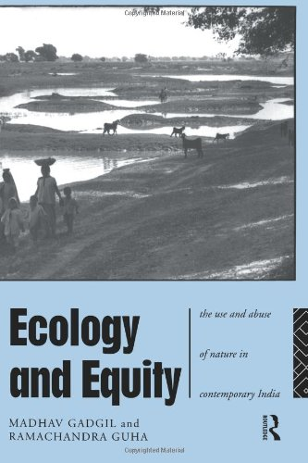
The problem of equity and social justice
Class and the use and abuse of natural resources (Guha and Gadgil)
Omnivores: industrialists, rich farmers, urban middle classes
Ecosystem people: Rural, those who rely on natural resources (small and marginal farmers, landless labour, pastoralists)
Ecological refugees: Displaced, evicted, resettled, migrants

Slide 8
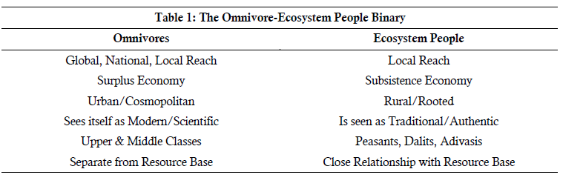
Thinking about sustainable development models: Avoiding Biases

Slide 9
Disparity between Northern and Southern countries (developed and developing)
R. Guha: full-stomach versus empty belly environmentalism
Conservation versus efficient and optimal use of resources
Enabling access to basic needs

Slide 10
Not Conservation or Protection but social conflicts around natural resources as the central environmental problem
Conflict and the problems of equity and access
Who owns resources?
Who should own them?
Who should manage resources?
What technologies should be used?
Who makes these decisions?

Slide 11
Questions about natural resource use, management, ownership, and costs
Why does resource degradation occur? The equity and power issue
Should resources be shared equitably, or be owned / used only by those who can afford to pay?
Should we pay for resources? How much should we pay?
The case of water
Delhi Water Privatisation Plan: criticism by Arvind Kejriwal
https://www.youtube.com/watch?v=8XwiyWgZHMA
Liquid City - Water Politics In Mumbai
https://www.youtube.com/watch?v=u2UPPjlgb9k

Slide 12
Not Conservation or Protection but social conflicts around natural resources as the central environmental problem
Issues arising from problems of equity, access, and justice

Slide 13

Questions about natural resource use, management, ownership, and costs
Why are there struggles / conflicts around natural resources? Why are we not able to share resources equitably?
To whom should resources belong? Private, public, common?
How should resources be governed or managed? Laws, Rules and Regulations, customs and traditions

Slide 14
Struggles and conflicts over resources:
Forest Resources: Use and over-exploitation, deforestation Timber extraction, mining, dams and their effects on forests and tribal people
Forest Rights Act, Forest Conservation Act, Social Forestry, Joint Forest Management
(Chipko / Appiko, Lekha Mendha)
b. Water Resources: Use and over-utilisation of surface and ground water, floods, drought, conflicts over water, dams - benefits and problems.
Inter-state, inter-regional, inter-country conflicts; people versus government or corporates; multi-purpose projects
(use material , videos and case studies of Plachimada, Narmada, Tehri Dam, Cauvery dispute, Mullaperiyar)

Slide 15
c. Mineral Resources: Use and exploitation, environmental effects of extracting and using mineral resources
Posco, Samata Judgement, Jadugoda
d. Nuclear Power: Post-Fukushima perspectives
Earlier: Chernobyl, Three Mile Island
Koodankulam and Jaitapur
e. Project related R&R
Singur, Nandigram, Dam projects, Mining projects, Airpots, Ports, other infrastructure projects: focus on both human impacts and environmental impacts in project area and resettlement area

Slide 16
Environmental Movements
Collective mobilization around issues of concern linking environmental issues to livelihoods and life
Greater Common Good? Links between environment, policy, technology choice, livelihoods, R&R, Justice, Equity, Biodiversity, Common Property Resources, Access to Resources for basic needs
Identify movements from your own state of region to understand better
History of resistance to environmental encroachment and resource grab: the continuing problem of resource curse

Slide 17
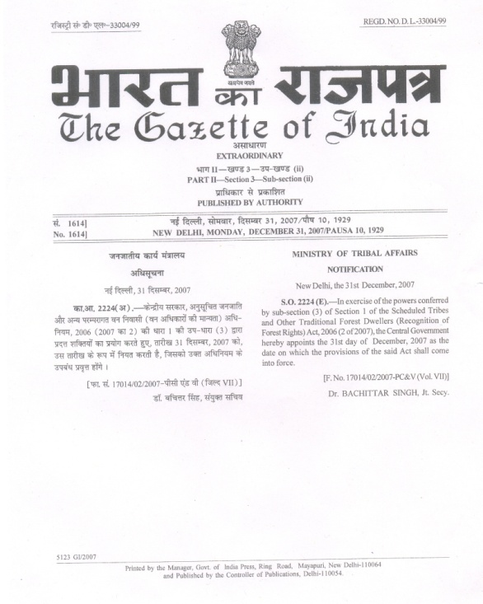
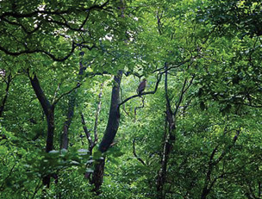
Forest Rights Act: Government, Forest based communities
Experiments in Resource Governance to promote equitable access and environmental sustainability
Forest Rights Act: Gajab Kahani - Struggle for Forest Rights: http://www.youtube.com/watch?v=EES2KtIdI3k

Slide 18
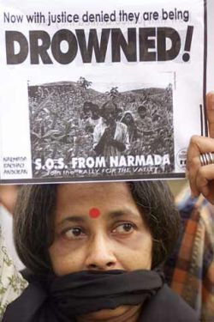
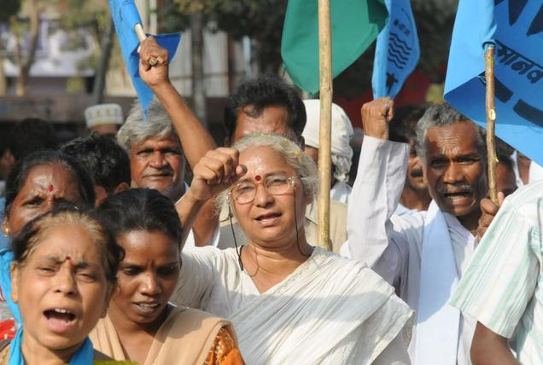
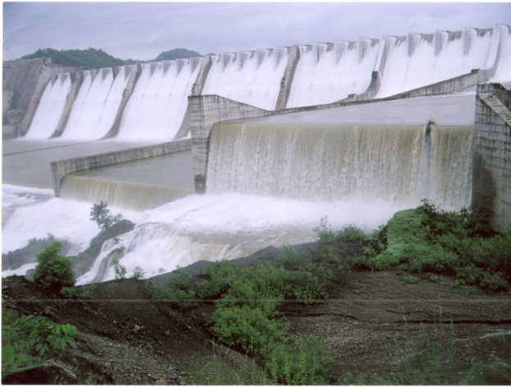
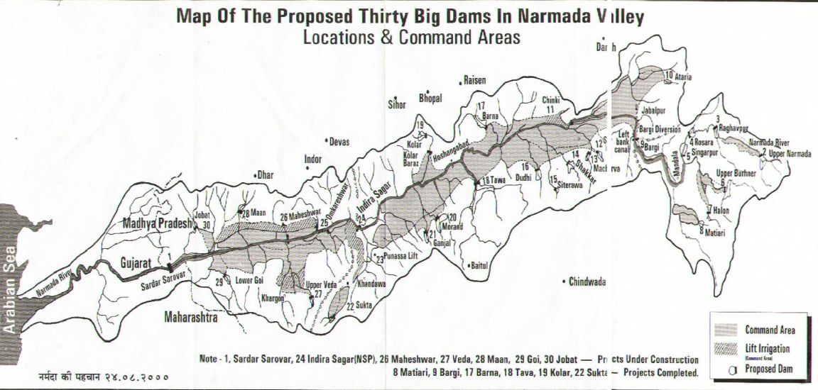
Sardar Sarovar Project (Narmada): Irrigation, Drinking Water, Hydro-electric power, Flood control

Slide 19
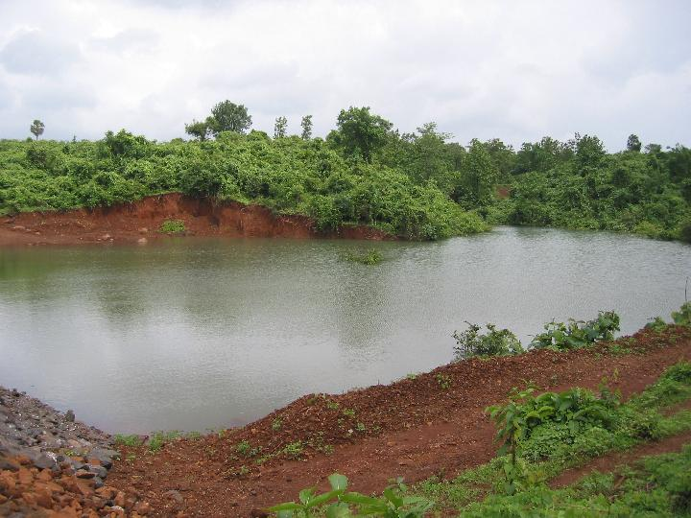
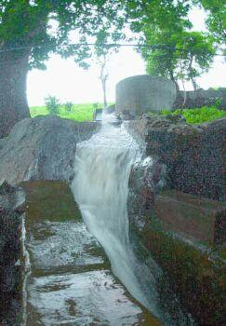
Small scale water solutions?
Belachiwadi Check Dam
Gudwan Check Dam
http://www.cse.iitb.ac.in/~ctara/dam/
Bilgaon

Slide 20
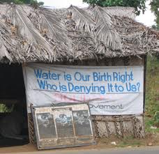
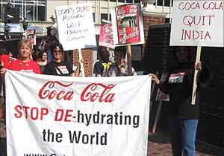
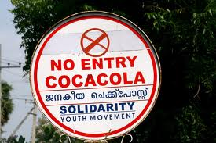
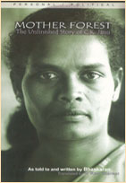
Plachimada: Private ownership vs public access to water (Coca Cola)
To whom does ground water belong?
Adivasi Samkrashana Sangham (Adivasi Protection Front)

